Slide 1




Session 1: Introduction to Synodality

Slide 2



Welcome & Introductions
Each person introduces themselves and what they like to do on a day off.
We will ask someone to go first, then please invite the next person by name.
Notes:
Welcome participants and facilitate introductions.

Slide 3

Overview of Session
Welcome, Introductions & Overview
Scripture Presentations & Debrief
Presentation: Introduction to Synodality
Breakout Groups
Large Group Sharing
Conclusion and Closing Prayer
Looking to the Next Session
Notes:
Give a general overview of session outline.

Slide 4

Scripture Presentations
You were invited to come today with a short scripture passage from anywhere in the Bible (no more than a few sentences) that relates to where you are on your spiritual journey.
We will break out into small groups to share our passages.
Read your passage.
Offer a two-minute reflection about how it applies to your life.
Listen without comment to the other members of your group.
Pause for 30 seconds after each person shares to reflect on what you heard.
After the pause, each person shares a few words in response to the reflection.
Notes:
Introduce Scripture Presentations process and break into small groups.

Slide 5
Scripture Presentations - Debrief
How was this experience
for you?
Notes:
Facilitate large group sharing on the Scripture Presentation process (the proclamation of Scripture, invoking the Holy Spirit through silent reflection in one another’s presence, and listening to how the Holy Spirit is prompting us.) Invite a few people to share a reflection on the question: How was that experience for you?

Slide 6

Presentation: Introduction to Synodality
Notes:
Use the facilitator’s guide and this sample slide deck to present an Introduction to Synodality.

Slide 7

What is Synodality?
Walking together in communion with Christ
encounter
listen
Kingdom
discern
Notes:
What is synodality? Synodality does not just refer to the meetings that were held in Rome. Yet it is also not the easiest concept to define. Here is an attempt in graphic form.
The term “synodality” comes from the Greek word synod, the root of which means “together” and “journey,” or as Pope Francis named it, “walking together in communion with Christ.”
The shorthand made popular by Pope Francis in his homily on the occasion of the opening of the Synod process is represented here on the left of screen: synodality calls us to encounter, listen, and discern. These are the three verbs that he said characterize synodality.
We walk together, in communion with Christ, towards the Kingdom of God, with the Holy Spirit as the protagonist.
Synodality is a way of proceeding, walking together.

Slide 8
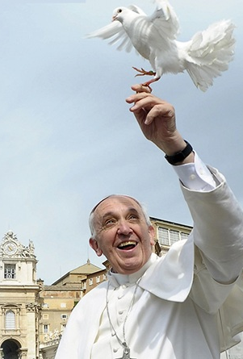
“To walk together is the constitutive way of the Church … only in this way can we address the complexity of this time.”
-Pope Francis (2017)
Notes:
“To walk together,” said Pope Francis, “is the constitutive way of the Church … only in this way can we address the complexity of this time.”

Slide 9
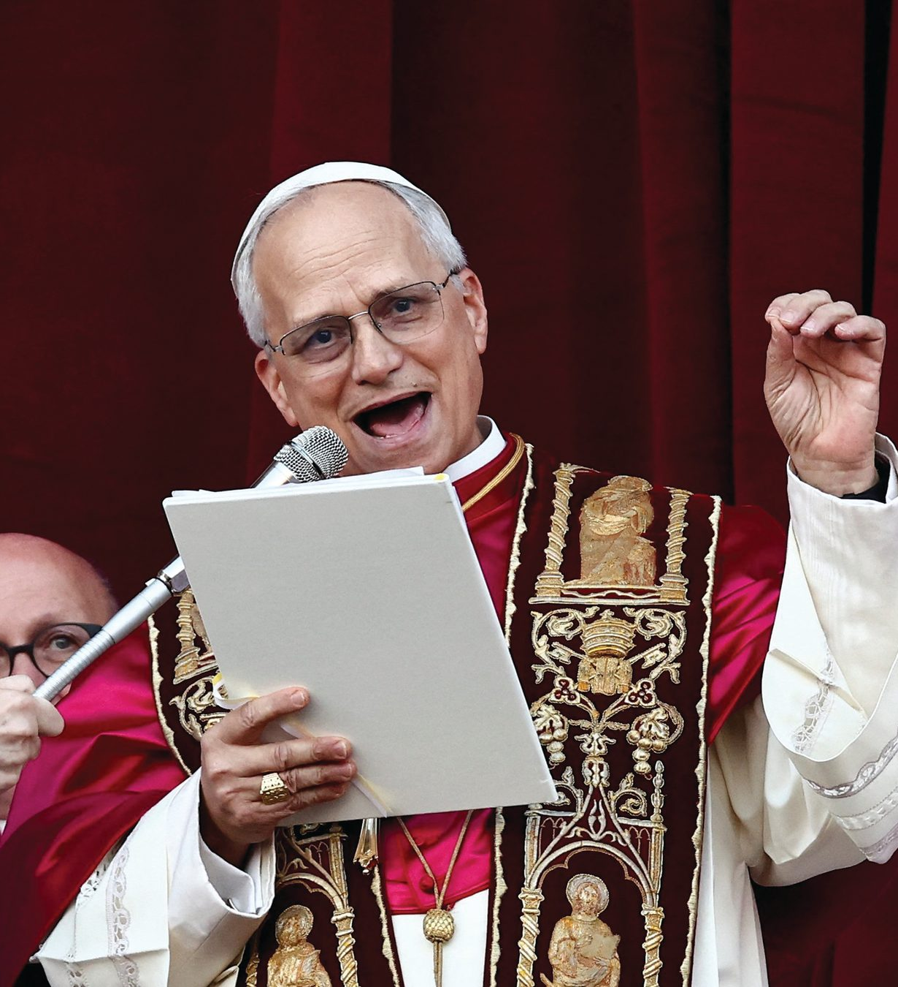
“We want to be a synodal Church”
-Pope Leo (2025)
Notes:
From his very first days, Pope Leo has committed the church to continue walking the path of synodality in the footsteps of Pope Francis, saying clearly, “We want to be a synodal church.”

Slide 10
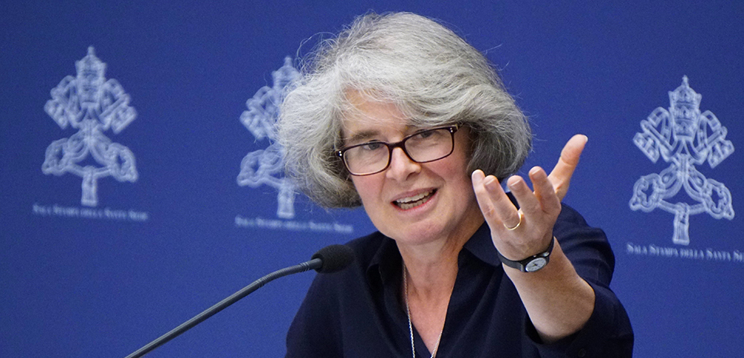
“Synodality is learning by doing.”
Nathalie Becquart, XMCJ
Undersecretary of the General Secretariat of the Synod
Notes:
Sister Nathalie Bequart, undersecretary of the General Secretariat of the Synod, has said that: “Synodality is learning by doing.”

Slide 11
Synodal Process and Methods
1
Hospitality and welcome
2
Extended listening and reflection
3
Periods of silent reflection and communal discernment
4
5
Checking biases and preconceptions
Resources and journaling between sessions
Notes:
This course will give you an experience of the synodal process and methods. We learn synodality experience.
Review of the synodal process and methods that will be used in the six sessions:
Hospitality and welcome
Extended listening and reflection
Periods of silent reflection and communal discernment
Checking biases and preconceptions
Resources and journaling between sessions
As you listen, consider: How is God calling us to journey as a community focused on the mission to proclaim the Gospel of Christ more effectively?

Slide 12
This course will emphasize
WHAT synodality is
  The topic of dialogue and discernment
HOW synodality is practiced
  Key elements of synodality
Notes:
We will emphasize WHAT synodality is (the topic of dialogue and discernment) and HOW synodality is practiced (key elements of synodality).

Slide 13
Hopes for the Experience
Experience ways to lead by utilizing the principles of Encounter, Listening, Discernment, Participation, and Accountability
1
Integrate principles of synodal leadership into your organizational leadership culture
2
Experience this leadership formation and possibly replicate within your network
3
Notes:
Review the stated objectives of the Course.
Experience ways to lead by utilizing the principles of Encounter, Listening, Discernment, Participation, and Accountability
Integrate principles of synodal leadership into their organizational leadership culture
Experience this leadership formation and possibly replicate within their network

Slide 14
Three Pillars of Synodal Process
Communion (Journeying Together)
Participation
(Co-Responsibility)
Mission
Notes:
The synodal process represents a way that we are Church:
Communion (Journeying Together)
Participation (Co-Responsibility)
Mission
The focus is to discern and identify ways the Holy Spirit is already at work among us, identify what may be lacking, who may not be at the table, and who we may need to hear from to go forward in faith.
As you listen, consider: How is God calling us to journey as a community focused on the mission to proclaim the Gospel of Christ more effectively?

Slide 15
Active Listening for Synodal Leadership
Communal Discernment & Participatory Decision-Making
Paths to Transformation: Overcoming Biases and Assumptions
A Framework for Leading Change: Adaptive Leadership
Building Bridges in the Church
Notes:
Briefly explain the remaining themes the Course will touch on, as well as the objective for each theme.
Active Listening: Understanding one another more fully through listening while withholding judgment
Communal Discernment & Participatory Decision-Making: Experiencing the movement of the Holy Spirit to guide our conversations in a group
Paths to Transformation: Becoming aware of our biases and assumptions for greater clarity in communication
Adaptive Leadership: Reflecting on how leaders can address complex challenges and create new approaches
Building Bridges Across Diverse Communities: Understanding the implications and the rich contribution of diversity and cultural differences

Slide 16
Small & Large Group Sharing
What excites you about what you heard?
What are some potential limitations or challenges about what you heard?
What might be challenging for you personally?
Notes:
In your breakout groups, please share in response to what you heard about the themes, objectives, and methods of synodality. Please consider what insight you want to report back to the large group after your breakout session.
As you hear about how we will interact with one another:
What excites you about what you heard?
What are some potential limitations or challenges about what you heard?
What might be challenging for you personally?

Slide 17
Reflection Question
What is your key takeaway from today?
Notes:
Invite participants into quiet reflection on the concluding question: Reflecting on your session experience, what is your key takeaway from today?
As time allows, invite participants to share with a partner or in the large group.

Slide 18


Closing Prayer
Notes:
Close the session with a simple prayer and sharing.
Does anyone have a prayer request, perhaps for someone you know who is struggling or someone who is celebrating a blessing?

Slide 19
Looking to the Next Session
Assignment: Reading and Video (in handout)
Questions:
What are examples of co-responsibility, shared governance, and inclusive listening that you have observed in the church?
What would you like to learn about synodality?
Notes:
The next session will be on the theme of Active Listening.
Refer to the preparation assignment including in the handout:
Before the next session, read Towards October 2024 (Synod document). (You may instead wish to have them read the Final Synod Document – available on the Vatican Website).
Write some notes in answer to the two questions below and be prepared to share at the next session.
What are examples of co-responsibility, shared governance, and inclusive listening that you have observed in the Church?
2. What would you like to learn more about synodality?
Also - Please watch this short video: Levels of Listening - Otto Scharmer

